Slide 1

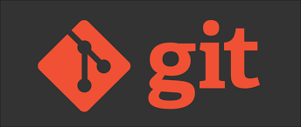

Slide 2
AGENDA
WHAT IS VERSION CONTROL SYSTEM
WHT IS GIT
NEED FOR GITHUB
WHAT IS GITHUB
GETTING STARTED WITH GITHUB
CREATE A REPOSITORY
CREATE A BRANCH
MAKE A COMMIT
OPEN AND MERGE PULL REQUEST

Slide 3
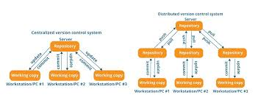
WHAT IS VERSION CONTROL SYSTEM
A version control system records the changes made to our code over time in a special database call repository.
We can look at our project history and see who has made what changes when and why.
Version control system fall into two categories centralized and distributed.

Slide 4

What is
GIT is a Devops tool used for source code management.
Git is a free and open source distributed version control system design to handle everything from small to very large projects with speed and efficiency.

Slide 5
THE NEED FOR GITHUB
Developers need a web/cloud based code hosting platform
Useful for version control
Enables effective collaboration
Download projects and files in one go
Easy evaluation of each other’s work

Slide 6
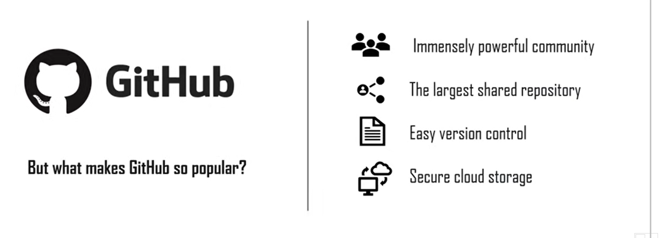
The NEED FOR GITHUB

Slide 7
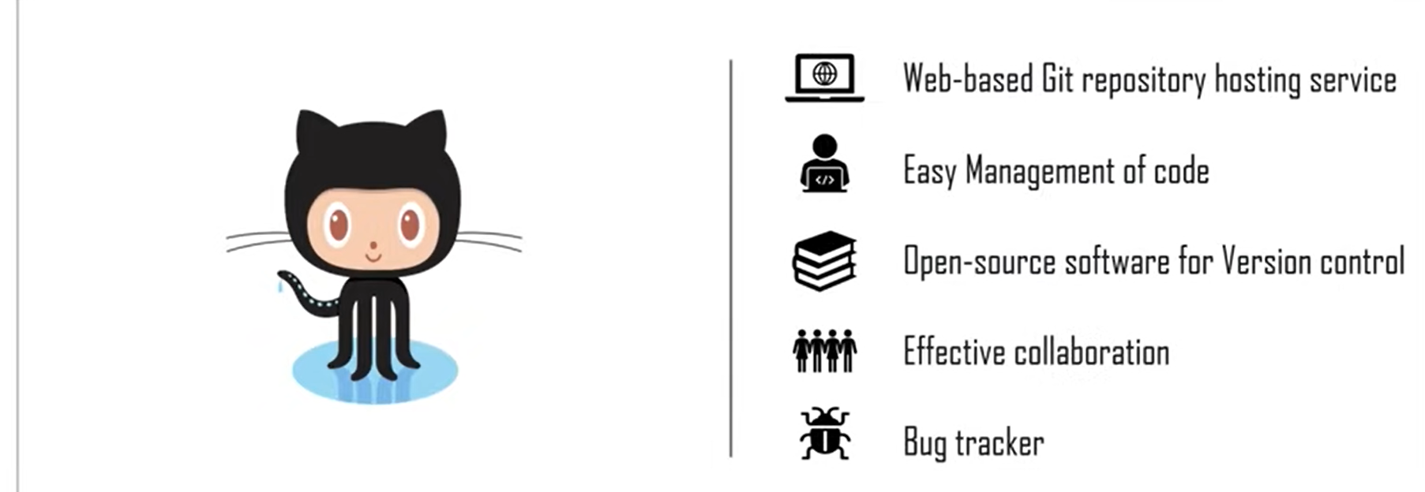
WHAT IS GITHUB

Slide 8
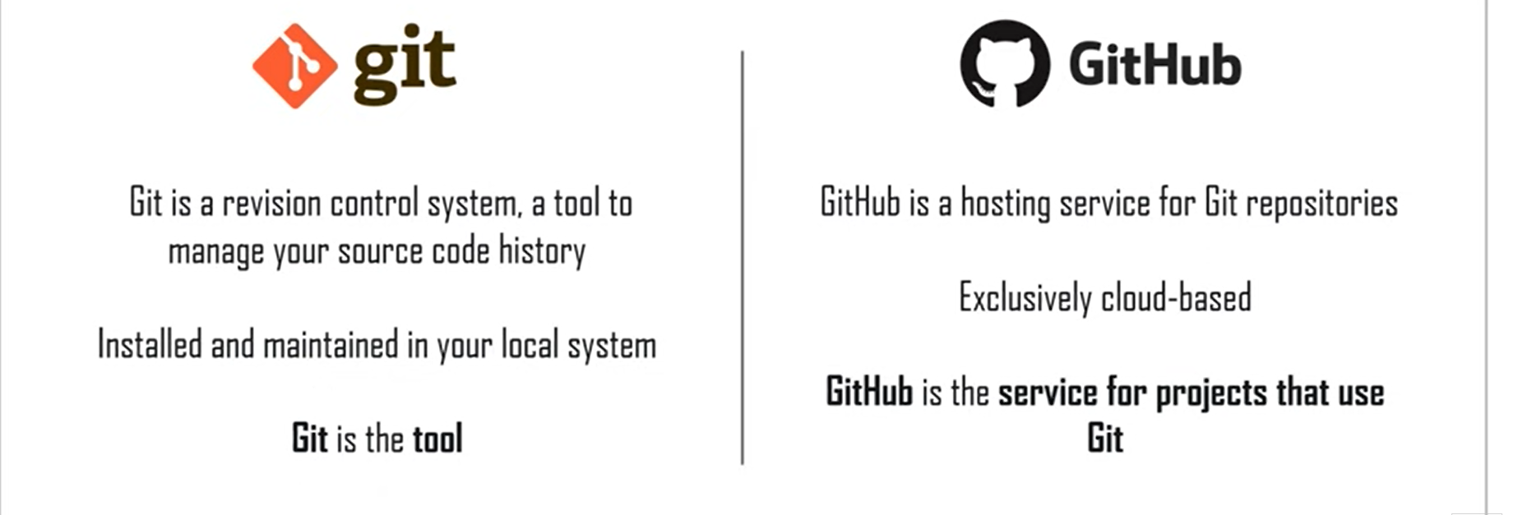
DIFFERENCE BETWEEN GIT AND GIT HUB

Slide 9

CREATE A REPOSITORY
Storage space for you project
Github is very popular central repository that allows you to share your files
Push your local repo into Github and share it with other collaborators via the central repo

Slide 10
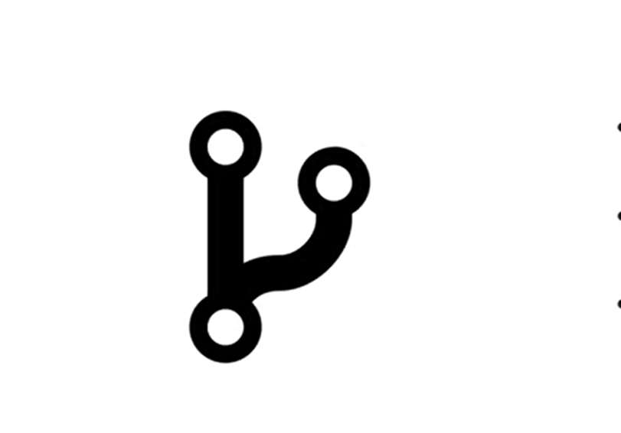
CREATE A BRANCH
Branches allow you to work on other features
They can be included with the main line of your project
The main branch – the one where all changes eventually get merged back in to and is called master

Slide 11

MAKE A COMMIT
Records changes to one or more files in your branch
Git assigns each commit a unique ID,called a SHA or hash ,that identifies:The specific changes

Slide 12
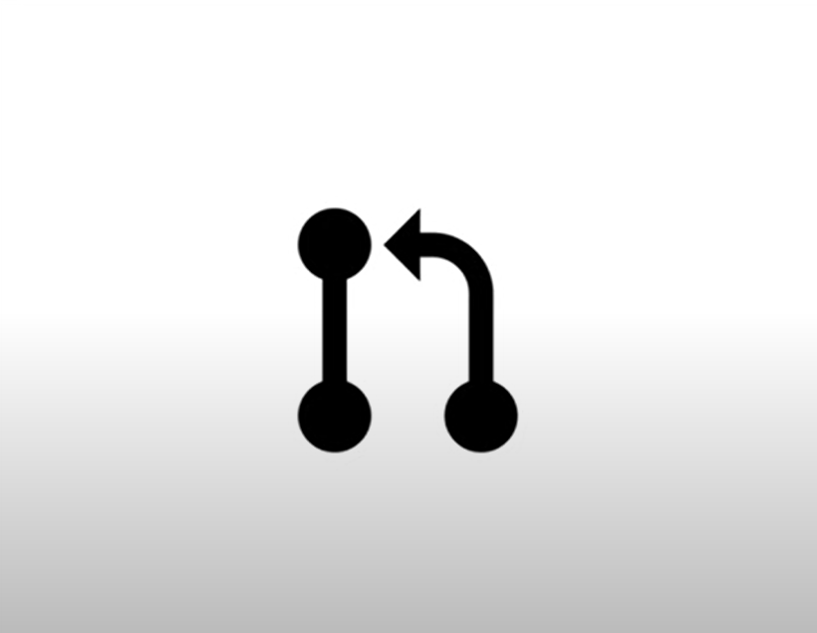
OPEN AND MERGE PULL REQUEST
Notifies developers about changes you have pushed to a branch in a repository
Acknlwledge and review changes
You can create a pull request on Github in 2 ways

